Slide 1
Soar Technology, Inc.

Slide 2



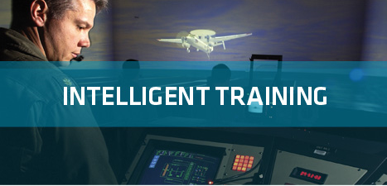
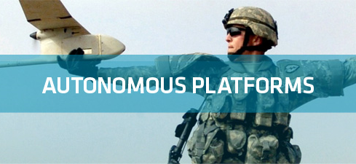
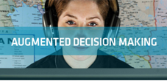
Soar Technology, Inc.
Spinoff of University of Michigan AI Lab (Soar Group)
R&D in Wide Array of Cognitive and Social Architecture Technologies
Market Segments
Full spectrum behavior models
Individually varied training
Mobile training
Control for Autonomous Platforms
Human-Robot Interfaces
Mixed Initiative Control
Intelligent User Interfaces
Behavior Modeling and Prediction
Reactive Planning
Focus Areas
MT-I (Army)
TigerBoard (Army)
SSIM (DARPA)
PercepTS (ONR)
RedRef (AFRL)
Helping our Heroes (OSD)
VESIP (Dept. of Ed)
Smart Interaction Devices (multiple)
SUMET (ONR)
LUCID (NAVAIR)
SAPIENT (CERDEC)
MAGIC (IRAD)
WEAVER (ONR)
SPRING (NSA)
SC2RAM (ONR)
C3E DUDE (IRAD)
Technology
Applications

Slide 3
Warfighter Problems
Intelligent
Training
Unmanned
Platforms
Data to
Decisions

Slide 4
Technology Innovations
Autonomy
Adaptation
Human/System
Interface

Slide 5
Warfighter Problems × Technology Innovations
Intelligent
Training
Unmanned
Platforms
Data to
Decisions
Autonomy
Adaptation
Human/System
Interface

Slide 6
Warfighter Problems × Technology Innovations
Intelligent
Training
Unmanned
Platforms
Data to
Decisions
Full Spectrum Behavior Models
Autonomy
Stack for
UxVs
Automated
Analysis of
Social Media
Autonomy
Individualized
Varied
Training
Interactive
Task
Learning
Abductive
Reasoning
Adaptation
Human/System
Interface
Multimodal
Student Sensing
Smart
Interaction
Devices
Adaptive
User
Interfaces

Slide 7
Example Technology Lineage
Autonomy
Natural Interaction
Multi-Entity
Control
-30% error
rate over
human
3x Mission
Completion
1:100
operator: AC
ratio
AutoATC
SUMET
STOW97
Multi-Control
Recognize Pilot
Behaviors
Situational
Awareness
CogArch for
Mission-Level
Planning
TacAir-Soar (HBMs)
Multi-Modal Interaction
Train Pilots
Medibot
RedRef
Interactive Cultural Characters
Mixed-Mode
Interaction
PnPCAT
SID
Explain HBM Behavior
User-Assistive
Monitoring
76% workload
reduction
Mixed-Mode
Dialogue
ECGF
Train ATCs
Tiger Board
Formative
Eval
CIANC
ROCCIE
ICF
HEAT
Winner
SAP
VISTA
2+D & Alerts
Task-Based
Alerts
Lucid
Generalize
Multiple HBMs
Task-based
Displays
Magic
2010
Sapient
BINAH
WEAVER
Context-aware
Displays
Initial Fleet
Deployment
AIA
SoarTech
Founded
1992
…
1998
…
2000
2002
2004
2006
2008
2010
2012 …
Notes:
Magic Competition
Lucid
Sapient

Slide 8
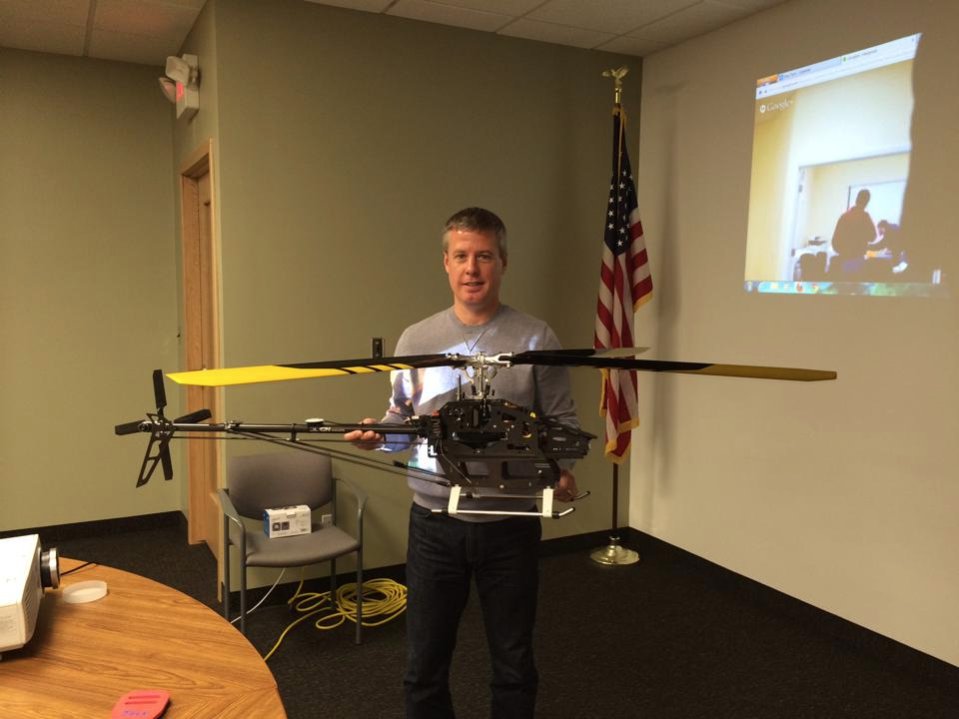
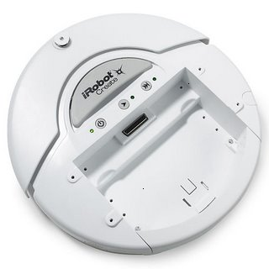
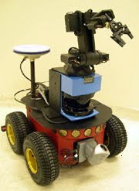
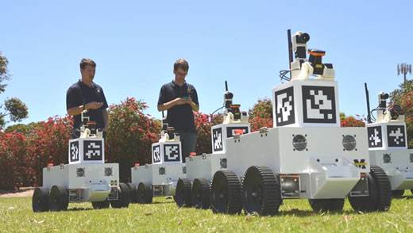
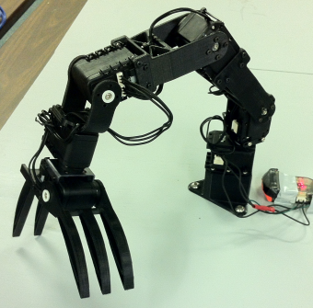
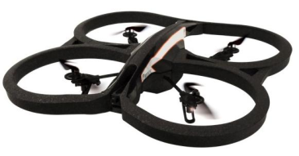
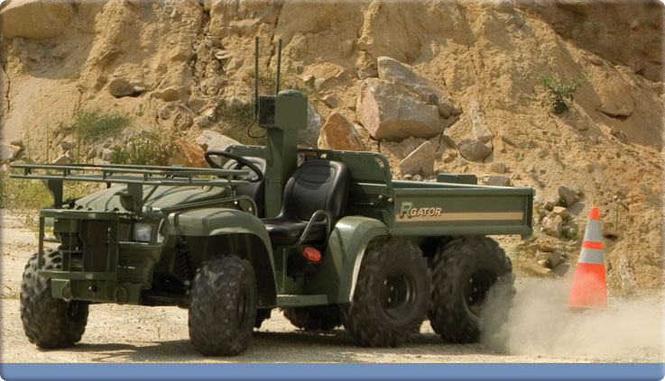
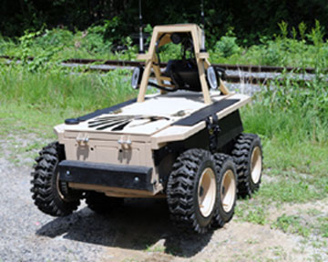
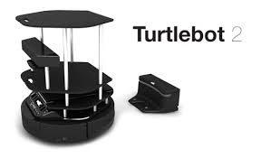
SoarTech’s Fleet of Robots

Slide 9
Contributions to the Soar community
jSoar
  jSoar 0.14.0 released this morning
  See Bob Marinier’s talk this morning
cSoar
  Addition of multiple new features to cSoar 9.3.3
    Math queries for semantic memory
    TCL support
  See Mazin’s talk this morning
  See Alex’s talk tomorrow
Preliminary comparison of Soar to other modeling approaches
  Used TankSoar as the task/domain
  See Jacob’s talk on Friday
Lots of contributions to Soar infrastructure
  SimRadio documentation
  SimJr documetation
  SoarIDE improvements??

Slide 10
Nuggets and Coal
Nuggets
  Transition success with TigerBoard/ STEAM
  Increased focus on Soar including Soar 9’s new features (eagerly awaiting SVS)
  SoarTech contributing code to the cSoar release
Coal
  A (hopefully brief) respite from our crazy-making rate of growth
  Awaiting the return of business as usual within the DoD S&T community
  Still a challenge to quantify the benefits of Soar

